Slide 1
Paper review: Estimation of Price Elasticities of demand for alcohol in the UK
Yu-Min Wang
Fall 2017
MKT 6v99

Slide 2
agenda
The Goal of the Paper
Dataset Overview
Problems in the Dataset
Sampling Distribution
Sampling Bias
Too Many Zero Observations
Using Heckman Correction Model
The Biggest Criticism of the Paper
Conclusion

Slide 3
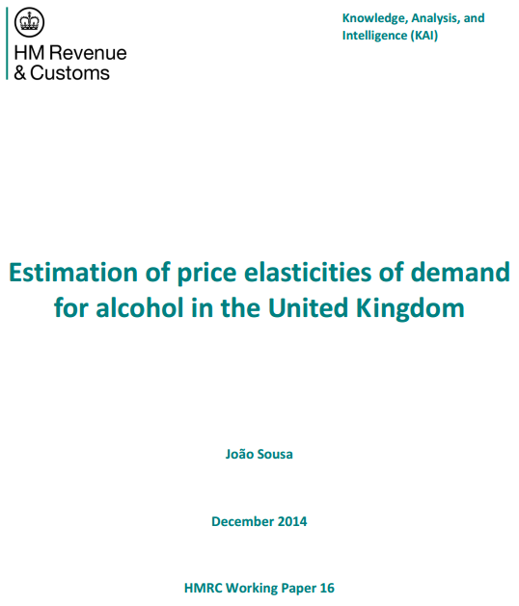
HMRC’s central analytical team
UK’s authority to collect tax, payments, & customs

Slide 4
paper goal
To estimate the impact to tax receipt (Exchequer) for 1% of increase in alcohol duty rates
alcohol elasticity
Total 10 elasticities need to be renewed
Beer
Wine
Spirit
On-trade*
Assumption :
Elasticities are different
between On-trade and
Off-trade
Cider
Ready-to-drink
Off-trade*
*On-trade : bar, club, restaurant, coffee shop…
*Off-trade: retail, supermarket, grocery…

Slide 5
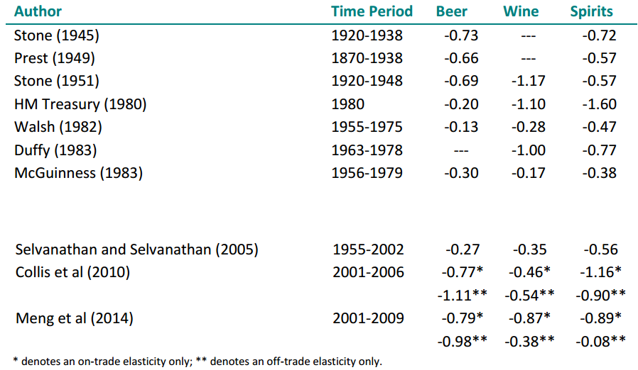
Historical estimated UK Elasticities for alcohol
.
.
.
.
.
.

Slide 6
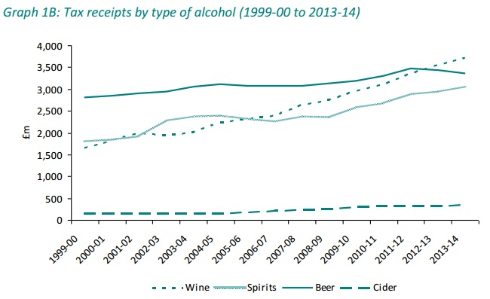
Tax receipts of alcohol
Annual £10.5 Billion
Wine
Beer
Spirit

Slide 7
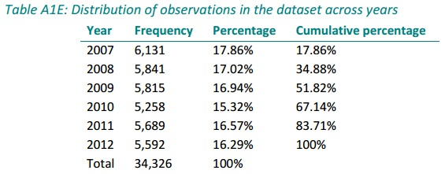
Dataset
Year 2007-2012
34,326 observations, each year around 6,000
From Living Cost and Food (LCF) Survey
Run by Office for National Statistics (ONS)
The largest cross-sectional survey in the UK
Household level

Slide 8
Problems of Dataset
No individual level (different gender, age… may cause different elasticity)
Cross-section (no time-series, no panel data)
Sampling bias (across regions, not random sampling…)
Many zero observations (0 quantity & missing price)
Average price granularity(Wine/Spirit has wide range in luxury/cheap class which may cause different elasticities)
Avg Price = Expense / Quantity

Slide 9
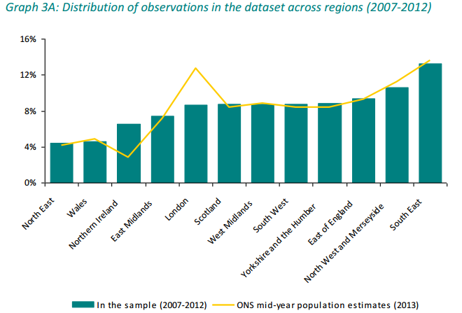
Sampling Distribution
N. Ireland could sample less
London should sample more
London could do a separate research of elasticity for its
highest household expenditures and most population

Slide 10
Sampling Bias
Not random sampling
Sampling within the range of 12,000 households
What made the households like to answer?
Heavy drinkers are often missing from the survey
Tend to lower alcohol consumption
Tend to overstate income & qualification

Slide 11
Many Zero Observations
1/3 of all households report no consumption of any type of alcohol
50% of households report no individual type of alcohol has been consumed
OLS estimates would be inconsistent and biased

Slide 12
Example of zero observations (case2)
N=2087
Price coefficient is positive
Parameter Estimates
Variable | Label | DF | Parameter Estimate | Standard Error | t Value | Pr > |t|
Intercept | Intercept | 1 | 1.35128 | 0.23012 | 5.87 | <.0001
paper_ns_qty | paper_ns_qty | 1 | 0.80610 | 0.08153 | 9.89 | <.0001
mail_cnt | mail_cnt | 1 | 0.11106 | 0.01381 | 8.04 | <.0001
proc reg data=case2.case2;
model paper_qty = paper_ns_qty mail_cnt ;
where clu=2 ;
N=707
Price coefficient is negative
Parameter Estimates
Variable | Label | DF | Parameter Estimate | Standard Error | t Value | Pr > |t|
Intercept | Intercept | 1 | 10.15838 | 0.72931 | 13.93 | <.0001
paper_ns_qty | paper_ns_qty | 1 | -0.87823 | 0.15511 | -5.66 | <.0001
mail_cnt | mail_cnt | 1 | 0.16558 | 0.02950 | 5.61 | <.0001
proc reg data=case2.case2;
model paper_qty = paper_ns_qty mail_cnt ;
where clu=2 & paper_qty>0;
Still can not solve the problem for the selection bias of
estimating the combined effect of buying and change in price

Slide 13

Heckman correction Model
Treats the censoring of observations as an omitted variable problem
2 equations
Participation equation
To estimate the probability that a certain individual has a non-zero obs.
Quantity equation
To estimate the quantity for individuals with non-zero obs.
di =1 if participation occurs, 0 otherwise
Probit

Slide 14
The author did not mention what tool (STATA, SAS…?) was used to do Heckman correction model.
Here I found some other STATA example on internet.
. heckman wearnl educ age, select(educ age z);
Equation of interest
Variables
in selection
equation
It seems SAS Proc QLIM has the similar function.

Slide 15
Biggest criticism
This paper uses Log of Price & Log of Qty to estimate elasticity,
assuming elasticity is constant along the demand curve.
Ex :
proc reg
model LogQty = β * LogPrice …
elasticity ε = β
I’d use what we’ve learned on class to estimate elasticity.
Ex :
proc reg
model Qty = β * Price …
elasticity ε = β * avgP / avgQ

Slide 16
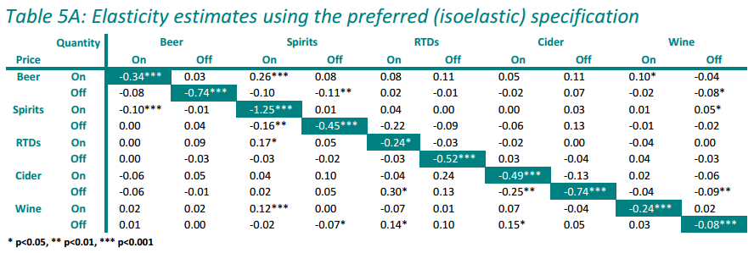
Estimation result
Only one alcohol is elastic : Spirit (On-trade)= 1.25
The most inelastic : Wine (Off-trade) = 0.08

Slide 17
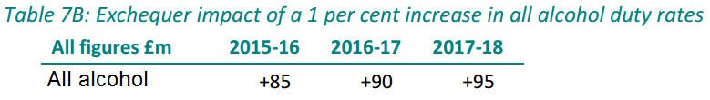
Impact on policy
1% increase in alcohol duty rate will cause £ 95 million
increase in tax receipt

Slide 18
Conclusion
Dataset : 2007-2012 LCF survey
Cross-sectional
Household level
Not random sampling
Sampling bias (heavy drinkers, tend to lower alcohol…)
No further granularity in Wine/Spirit class
Too many zero observations
Analysis : Heckman correction model
No mention what analytics tool
Using Log of price and Log of Qty to estimate elasticity

